Slide 1
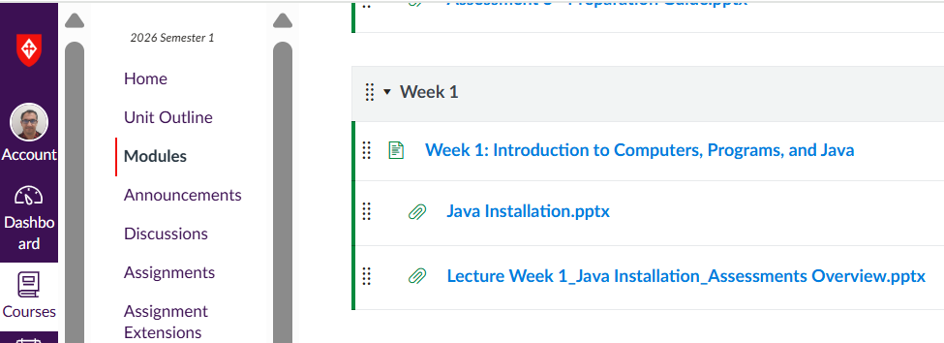
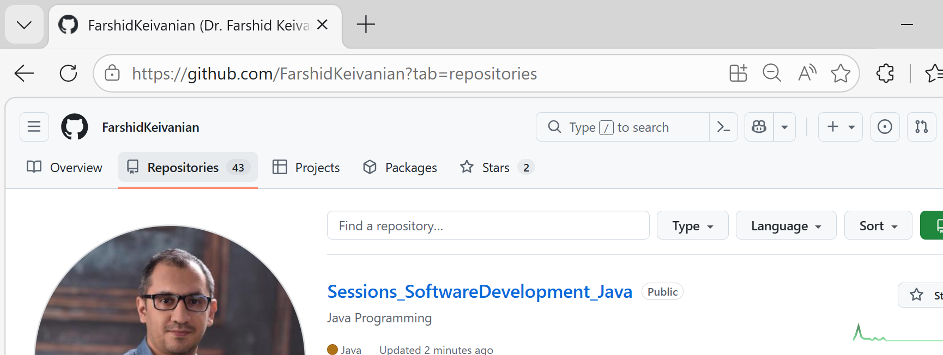
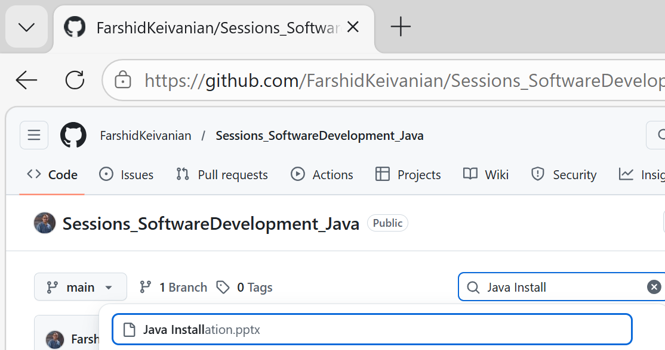
Java Installation

Slide 2
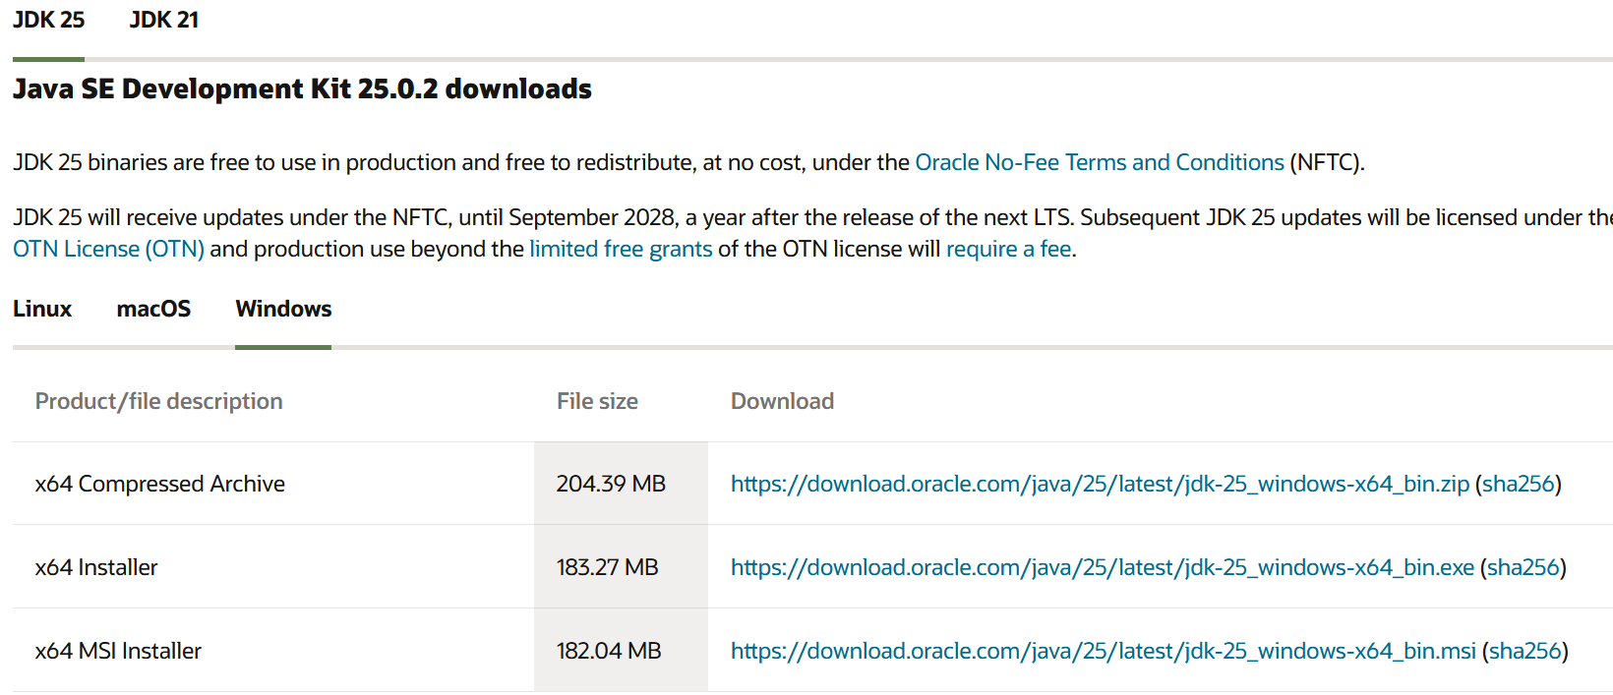
Java Installation:
Download and install the idk package https://www.oracle.com/au/java/technologies/downloads/#jdk22-windows

Slide 3
Java Installation:
Mac users can install:
Eclipse IDE for Java Developers – 2024-06 version
It works on macOS (Intel and Apple Silicon).
Steps:
Install JDK (Temurin or Oracle JDK 17+)
Download Eclipse for macOS
Extract and run

Slide 4
Java Installation:
Do We Recommend Google Colab?
X No, not for this unit.
Reasons:
Colab is mainly for Python
Java support is limited
No proper IDE experience
Not suitable for OOP projects

Slide 5
Java Installation:
Better options:
Eclipse (recommended)
IntelliJ Community Edition
VS Code (with Java extension)
If needed, Mac students can:
Install Eclipse
Use IntelliJ
Borrow a Windows laptop (if installation issues)

Slide 6
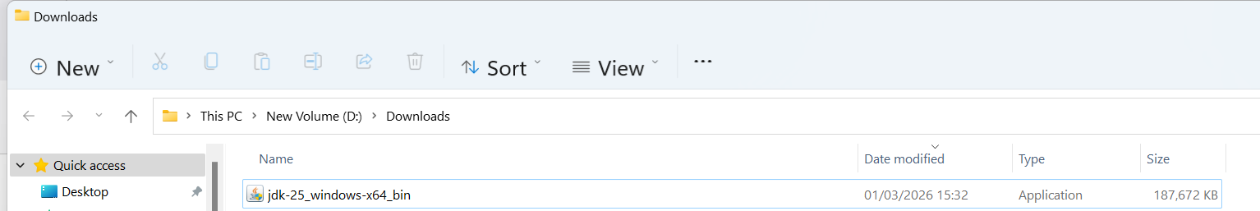

Slide 7
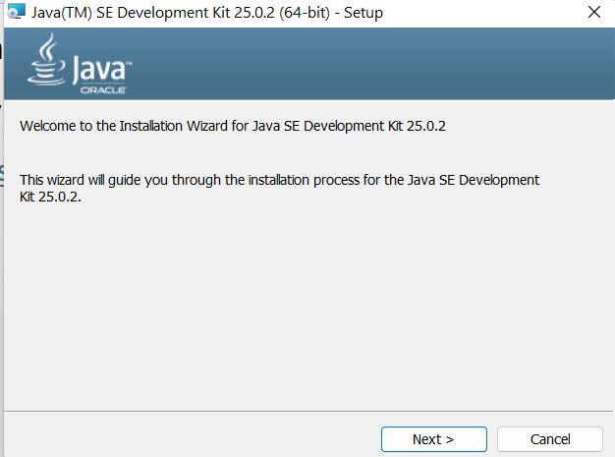
Java Installation:
Download and install the idk package https://www.oracle.com/au/java/technologies/downloads/#jdk22-windows

Slide 8
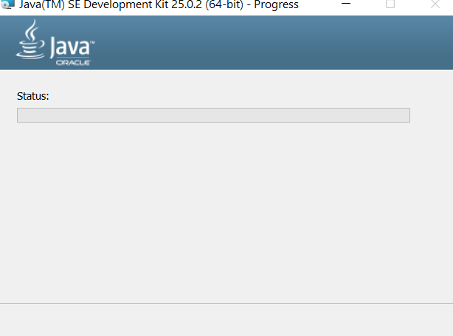
Java Installation:
Download and install the idk package https://www.oracle.com/au/java/technologies/downloads/#jdk22-windows

Slide 9
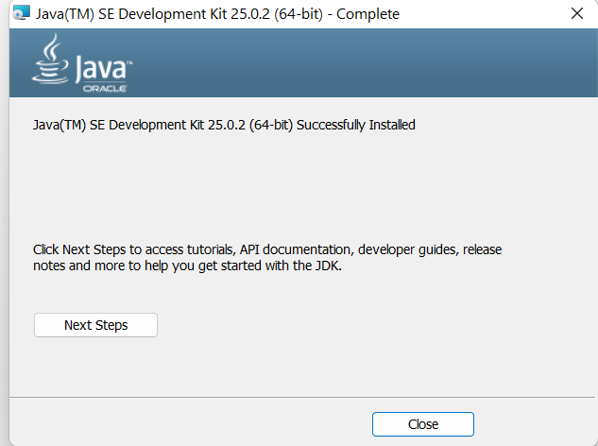
Java Installation:
Download and install the idk package https://www.oracle.com/au/java/technologies/downloads/#jdk22-windows

Slide 10
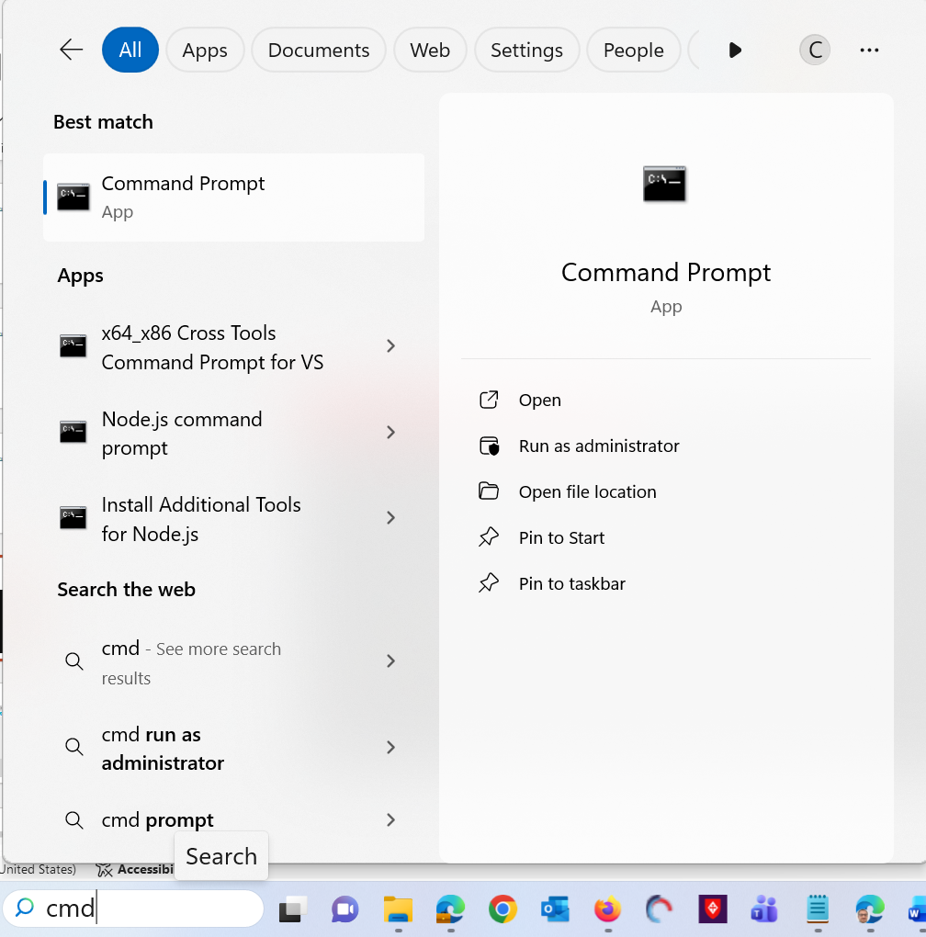
Java Installation:
Type cmd to run command Prompt in Windows

Slide 11
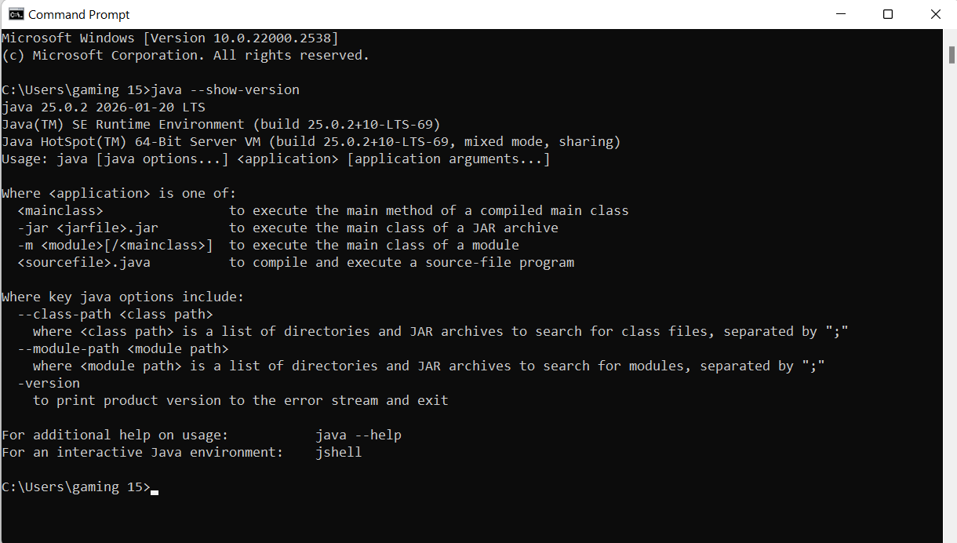
Java Installation:
Command Prompt Windows / Terminal in MAC: java –show-version

Slide 12
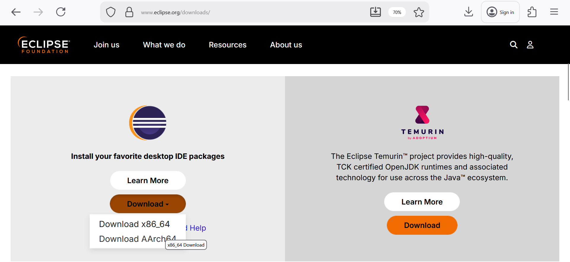
Java Installation:
Download Eclipse Software https://www.eclipse.org/downloads/

Slide 13
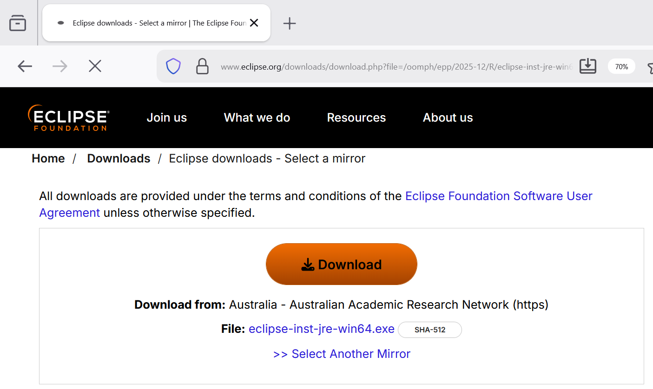
Java Installation:

Slide 14
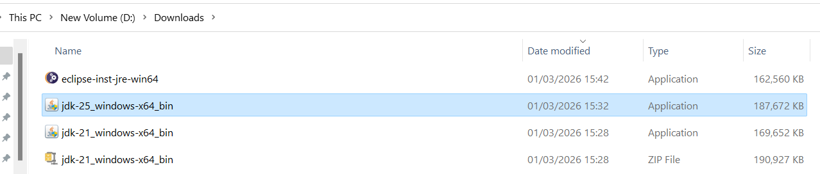
Java Installation:

Slide 15
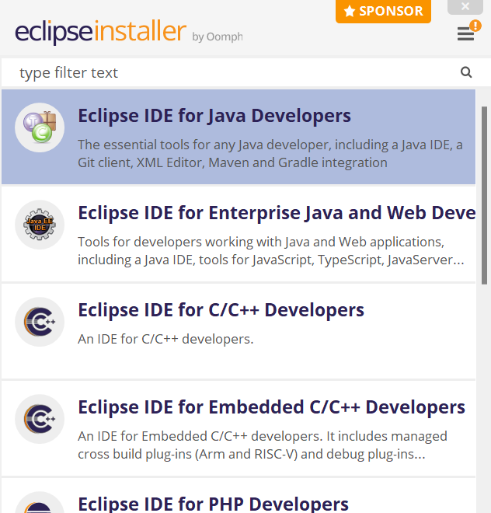
Java Installation:

Slide 16
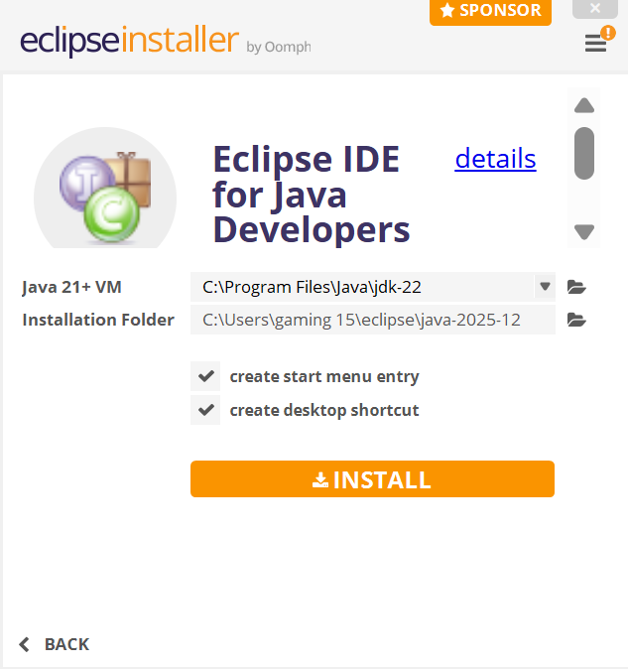
Java Installation:

Slide 17
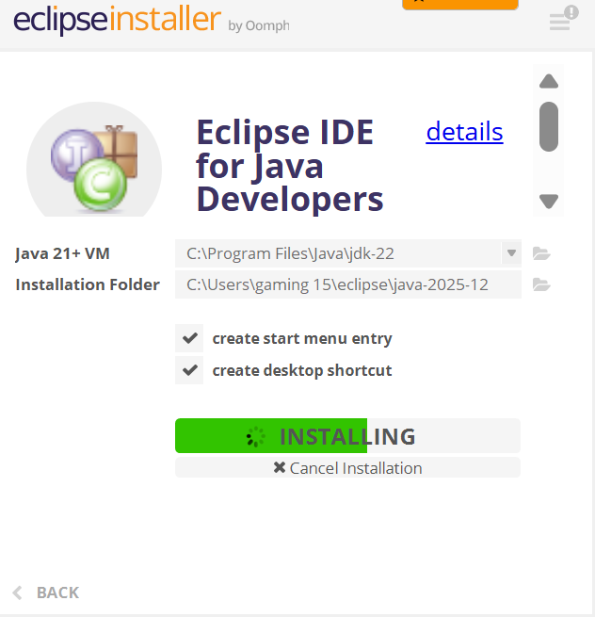
Java Installation:

Slide 18
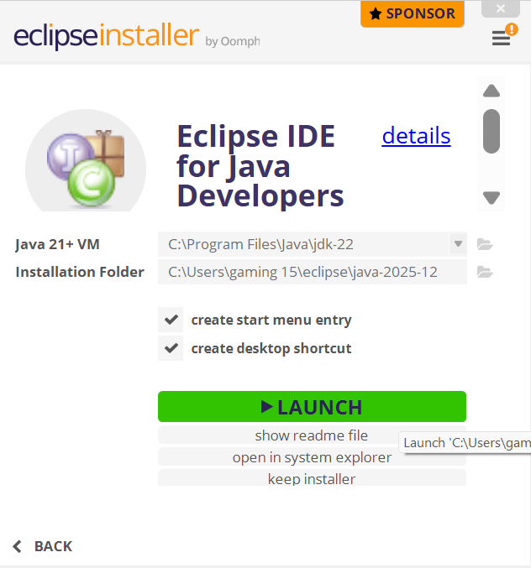
Java Installation:

Slide 19
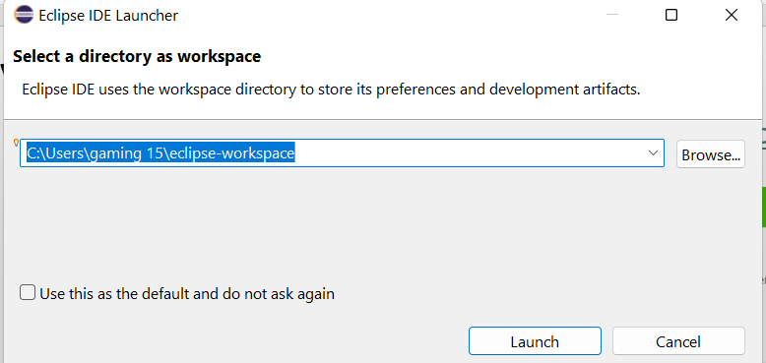
Java Installation:

Slide 20
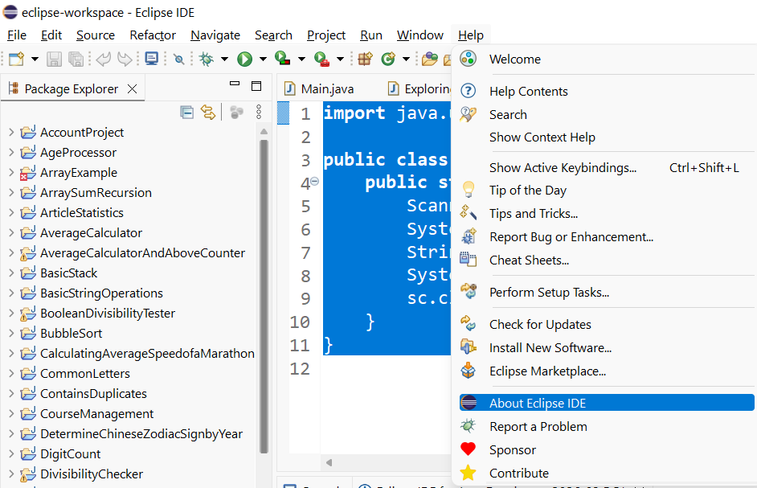
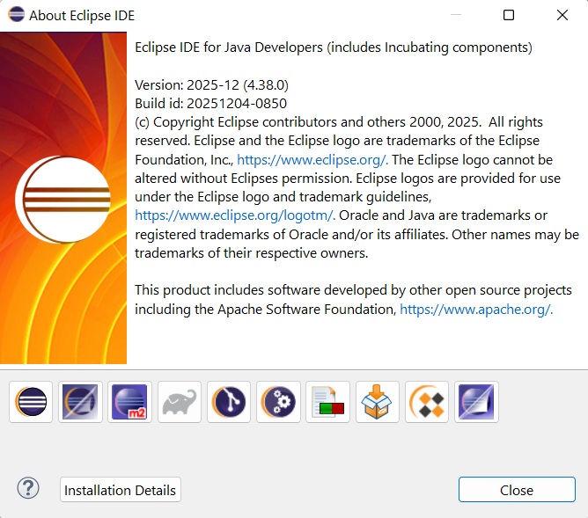
Java Installation:

Slide 21
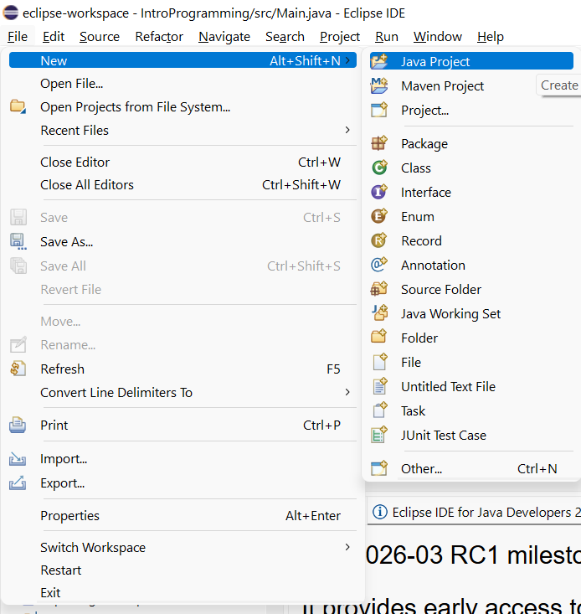
Welcome to Java

Slide 22
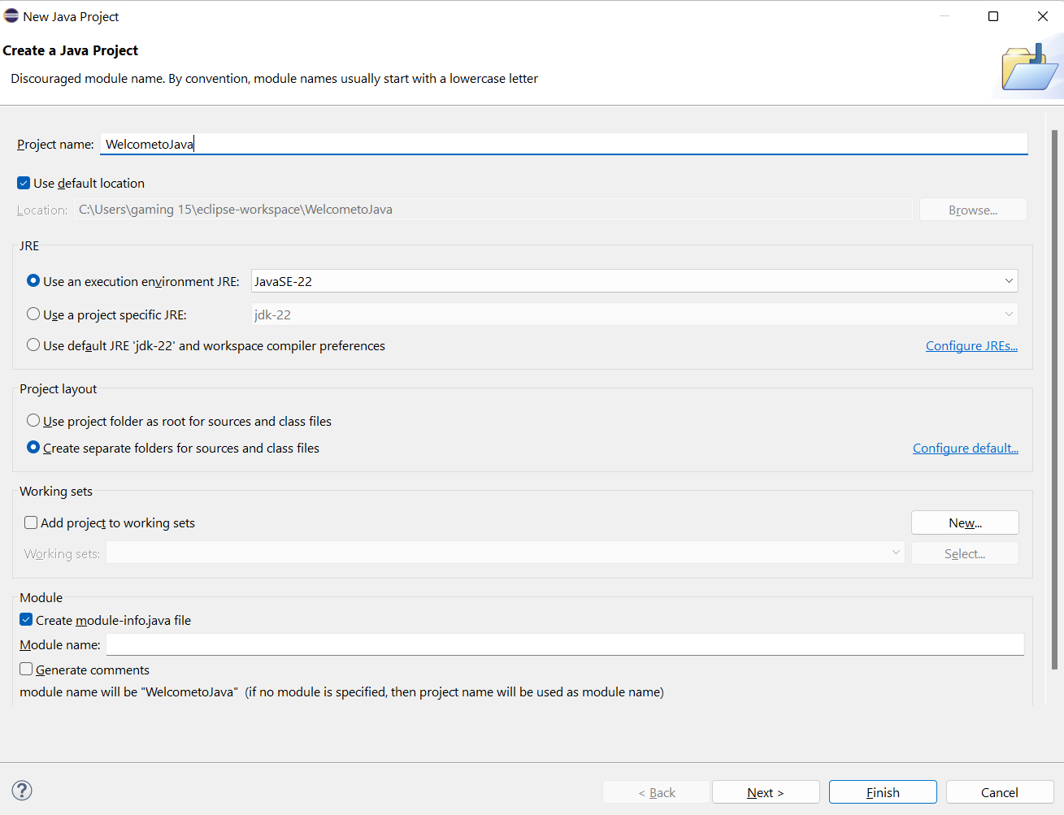
Welcome to Java

Slide 23
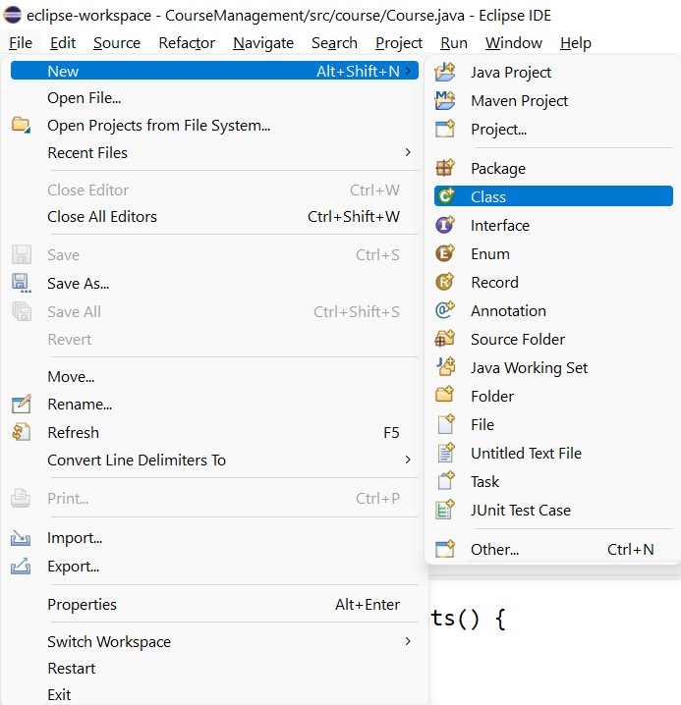
Welcome to Java

Slide 24
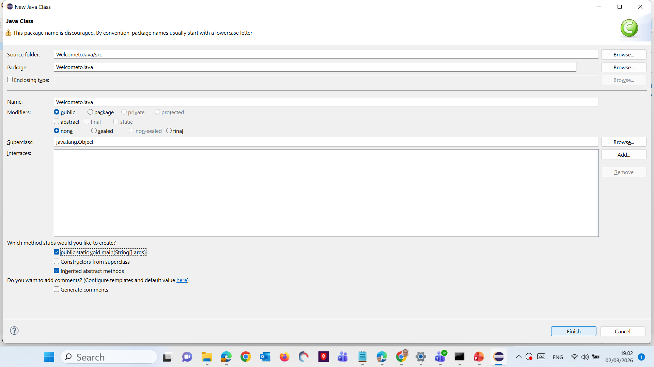
Welcome to Java

Slide 25
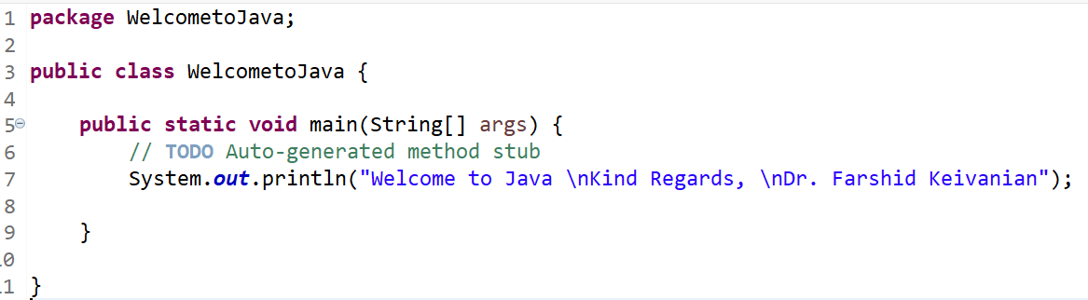
Welcome to Java

Slide 26
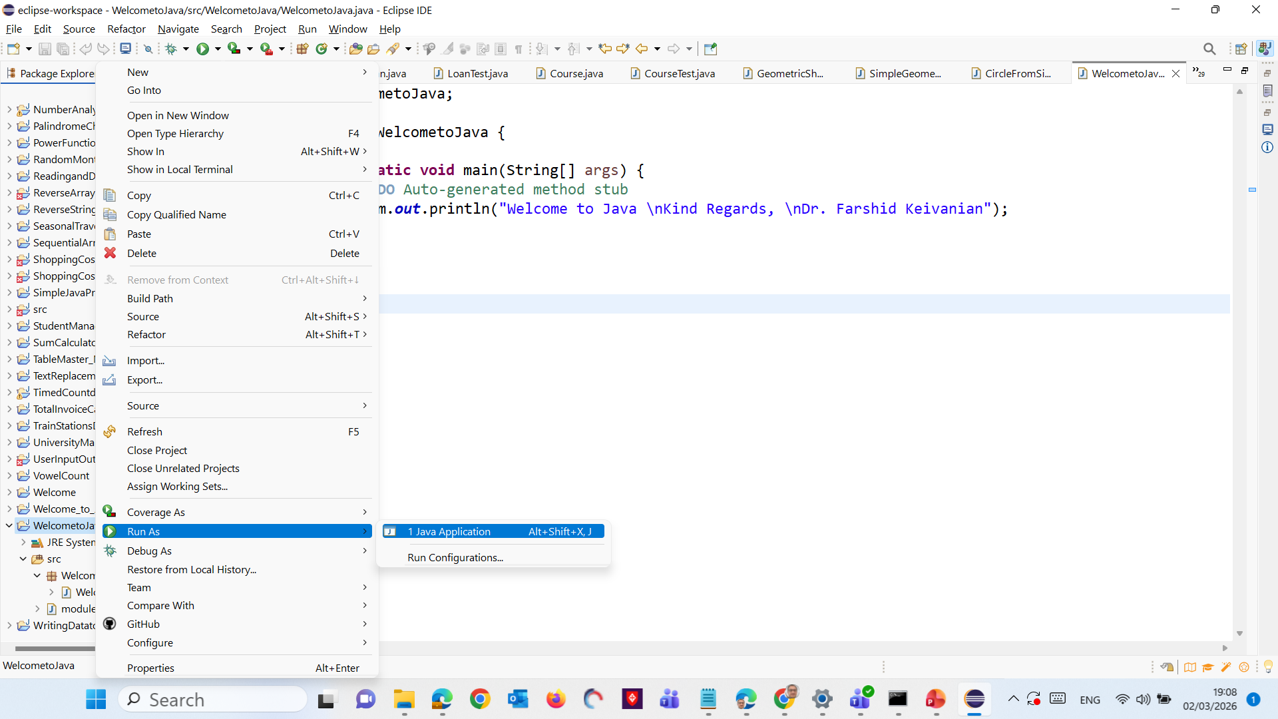
Welcome to Java
Right Click on Package or Class and Select Run As >> Select Java Application

Slide 27
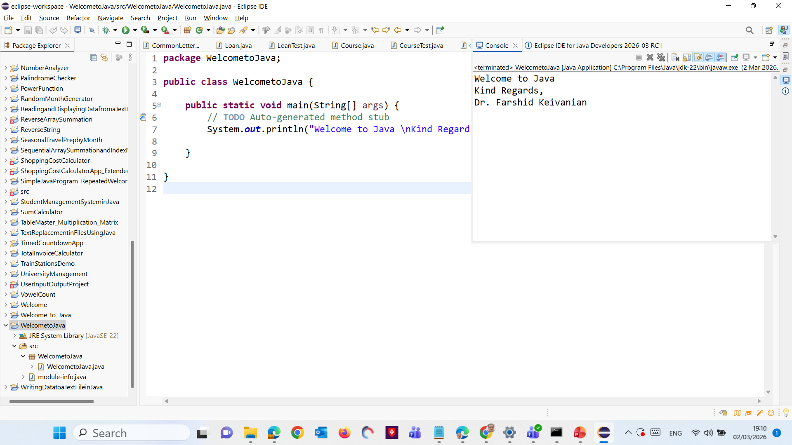
Welcome to Java

Slide 28
Welcome to Java
public class Welcome: Defines a public class named Welcome.
public static void main(String[] args): The main method is the entry point of the program.

Slide 29
Welcome to Java
System.out.println("Welcome to Java \nKind Regards, \nDr. Farshid Keivanian");: Prints the message "Welcome to Java!" to the console.
This simple program introduces you to the fundamental components of a Java program, such as classes, methods, and the standard output function. By running this program, you get a practical understanding of how Java code is structured and executed.

Slide 30
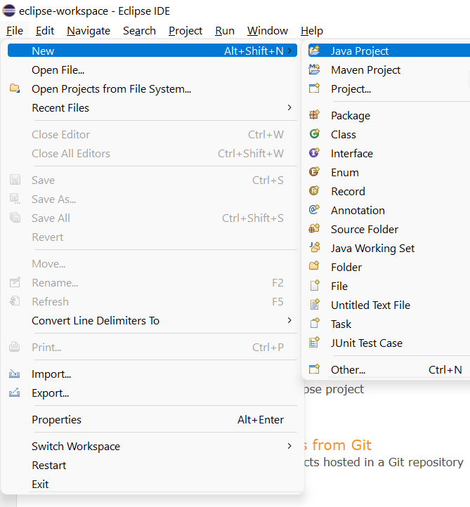
Simple User Input and Output Analysis in Java
1. Click on "Create a new Java project":
This will open a new window where you can set up your project.

Slide 31
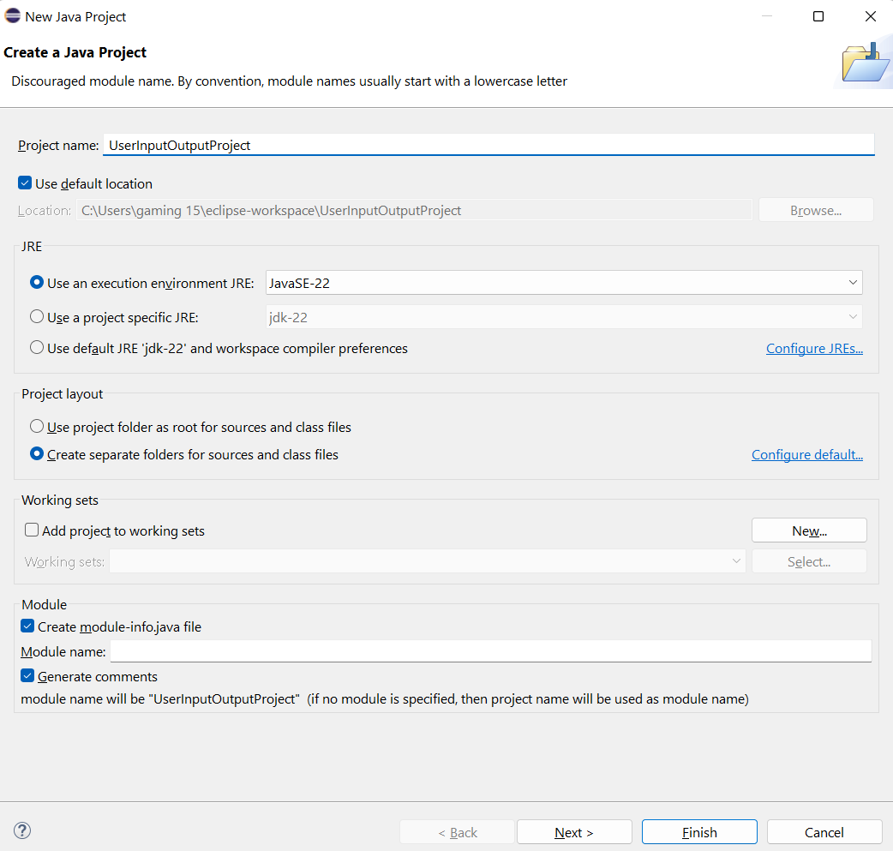
Simple User Input and Output Analysis in Java
2. Set up the new project:
Enter a project name (e.g., UserInputOutputProject).
Click Finish.

Slide 32
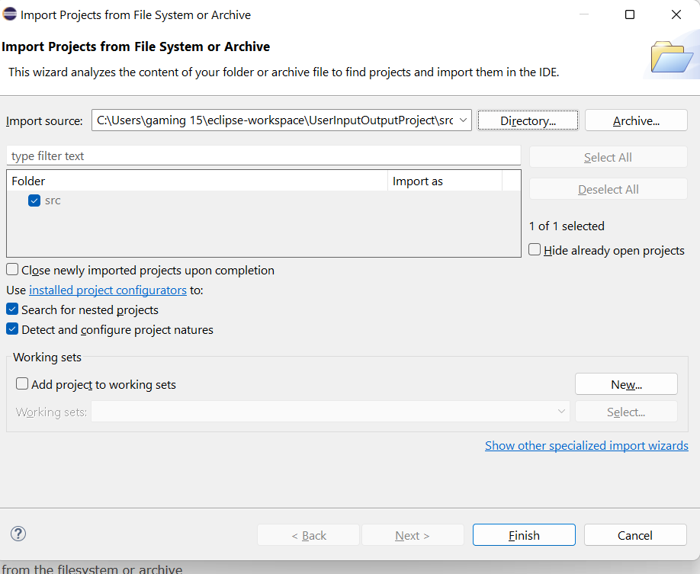
Simple User Input and Output Analysis in Java

Slide 33
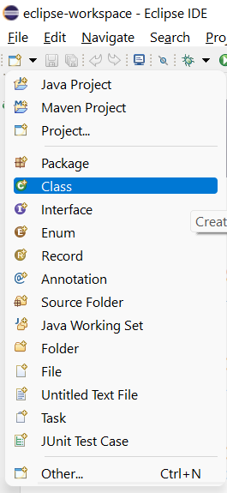
Simple User Input and Output Analysis in Java
3. Create a new Java class:
File >> Open Projects from File Systems >> Directory >> Choose the Direct where the Project is Saved ‘e.g. C:\Users\gaming 15\eclipse-workspace\UserInputOutputProject\src’
Click on Select Folder
Select New > Class.

Slide 34
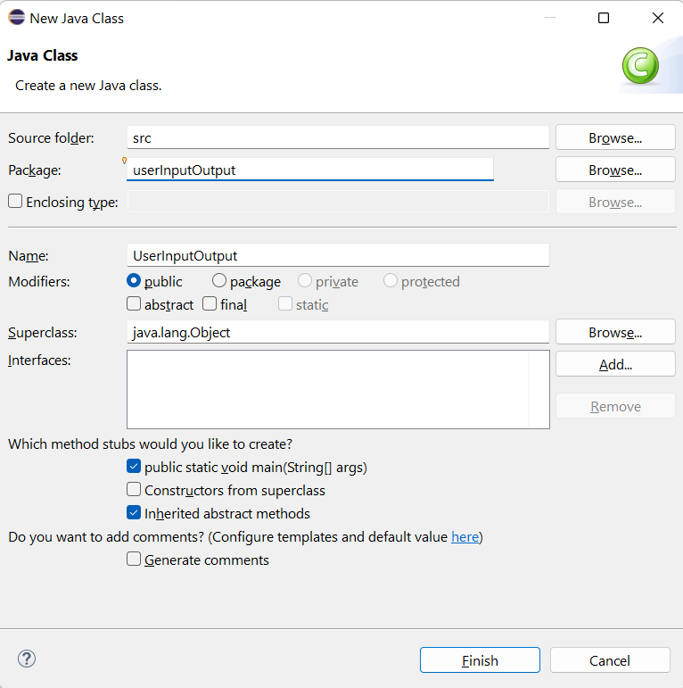
Simple User Input and Output Analysis in Java
Enter a class name (e.g., UserInputOutput).
Ensure the public static void main(String[] args) option is checked.
Click Finish.
Click on Hide (Front Page)

Slide 35
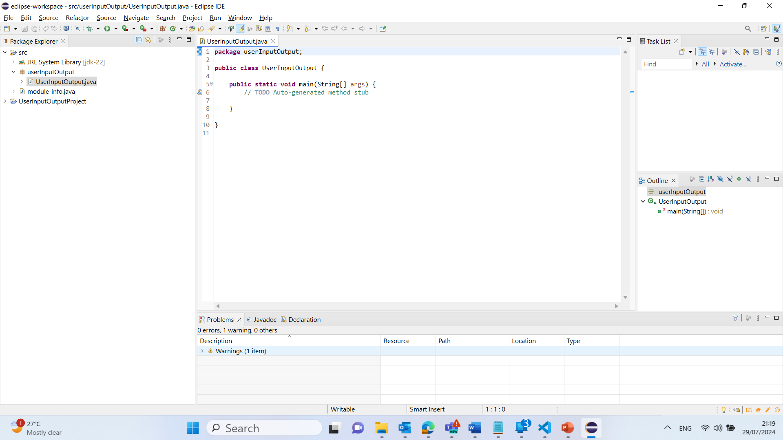
Simple User Input and Output Analysis in Java
4. Write Java code:
Write the code into the newly created class:

Slide 36
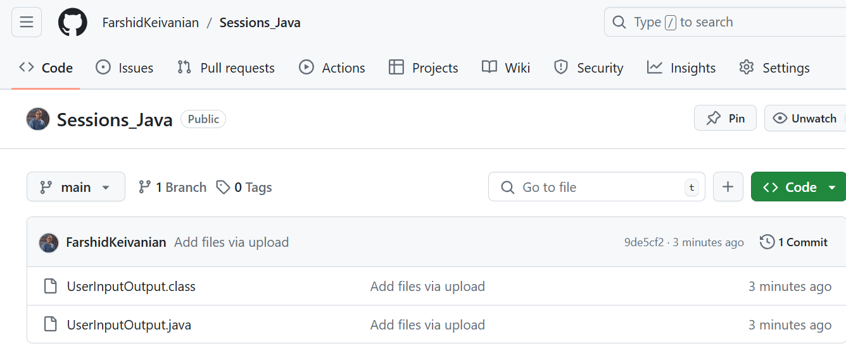
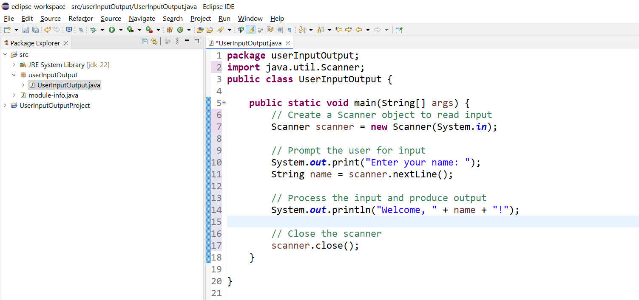
package userInputOutput;
import java.util.Scanner;
public class UserInputOutput {
public static void main(String[] args) {
// Create a Scanner object to read input
Scanner scanner = new Scanner(System.in);
// Prompt the user for input
System.out.print("Enter your name: ");
String name = scanner.nextLine();
// Process the input and produce output
System.out.println("Welcome, " + name + "!");
// Close the scanner
scanner.close();
}
}
1. Import Statement:
import java.util.Scanner;
This line imports the Scanner class, which is used for reading input from the user.

Slide 37
package userInputOutput;
import java.util.Scanner;
public class UserInputOutput {
public static void main(String[] args) {
// Create a Scanner object to read input
Scanner scanner = new Scanner(System.in);
// Prompt the user for input
System.out.print("Enter your name: ");
String name = scanner.nextLine();
// Process the input and produce output
System.out.println("Welcome, " + name + "!");
// Close the scanner
scanner.close();
}
}
2. Class Declaration:
public class UserInputOutput {
This line declares a public class named UserInputOutput

Slide 38
package userInputOutput;
import java.util.Scanner;
public class UserInputOutput {
public static void main(String[] args) {
// Create a Scanner object to read input
Scanner scanner = new Scanner(System.in);
// Prompt the user for input
System.out.print("Enter your name: ");
String name = scanner.nextLine();
// Process the input and produce output
System.out.println("Welcome, " + name + "!");
// Close the scanner
scanner.close();
}
}
3. Main Method:
public static void main(String[] args) {
This is the entry point of the program where execution begins.

Slide 39
package userInputOutput;
import java.util.Scanner;
public class UserInputOutput {
public static void main(String[] args) {
// Create a Scanner object to read input
Scanner scanner = new Scanner(System.in);
// Prompt the user for input
System.out.print("Enter your name: ");
String name = scanner.nextLine();
// Process the input and produce output
System.out.println("Welcome, " + name + "!");
// Close the scanner
scanner.close();
}
}
4. Scanner Object Creation:
Scanner scanner = new Scanner(System.in);
This line creates a Scanner object to read input from the standard input stream (keyboard).

Slide 40
package userInputOutput;
import java.util.Scanner;
public class UserInputOutput {
public static void main(String[] args) {
// Create a Scanner object to read input
Scanner scanner = new Scanner(System.in);
// Prompt the user for input
System.out.print("Enter your name: ");
String name = scanner.nextLine();
// Process the input and produce output
System.out.println("Welcome, " + name + "!");
// Close the scanner
scanner.close();
}
}
5. Prompting for Input:
System.out.print("Enter your name: ");
This line prompts the user to enter their name.
6. Reading Input:
String name = scanner.nextLine();
This line reads the user's input and stores it in a variable named name.

Slide 41
package userInputOutput;
import java.util.Scanner;
public class UserInputOutput {
public static void main(String[] args) {
// Create a Scanner object to read input
Scanner scanner = new Scanner(System.in);
// Prompt the user for input
System.out.print("Enter your name: ");
String name = scanner.nextLine();
// Process the input and produce output
System.out.println("Welcome, " + name + "!");
// Close the scanner
scanner.close();
}
}
7. Producing Output:
System.out.println("Welcome, " + name + "!");
This line outputs a welcome message that includes the user's name.
8. Closing the Scanner:
scanner.close();
This line closes the Scanner object to free up resources.

Slide 42
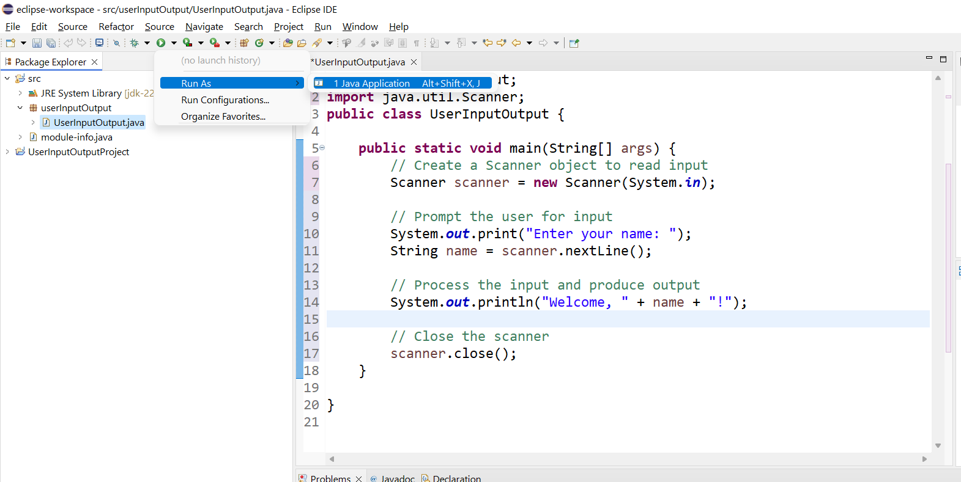
5. Run the Java program:
Right-click on your Java file (e.g., UserInputOutput.java).
Select Run As > Java Application.
This will execute Java program, allowing you to enter your name and see the welcome message displayed in the console.

Slide 43
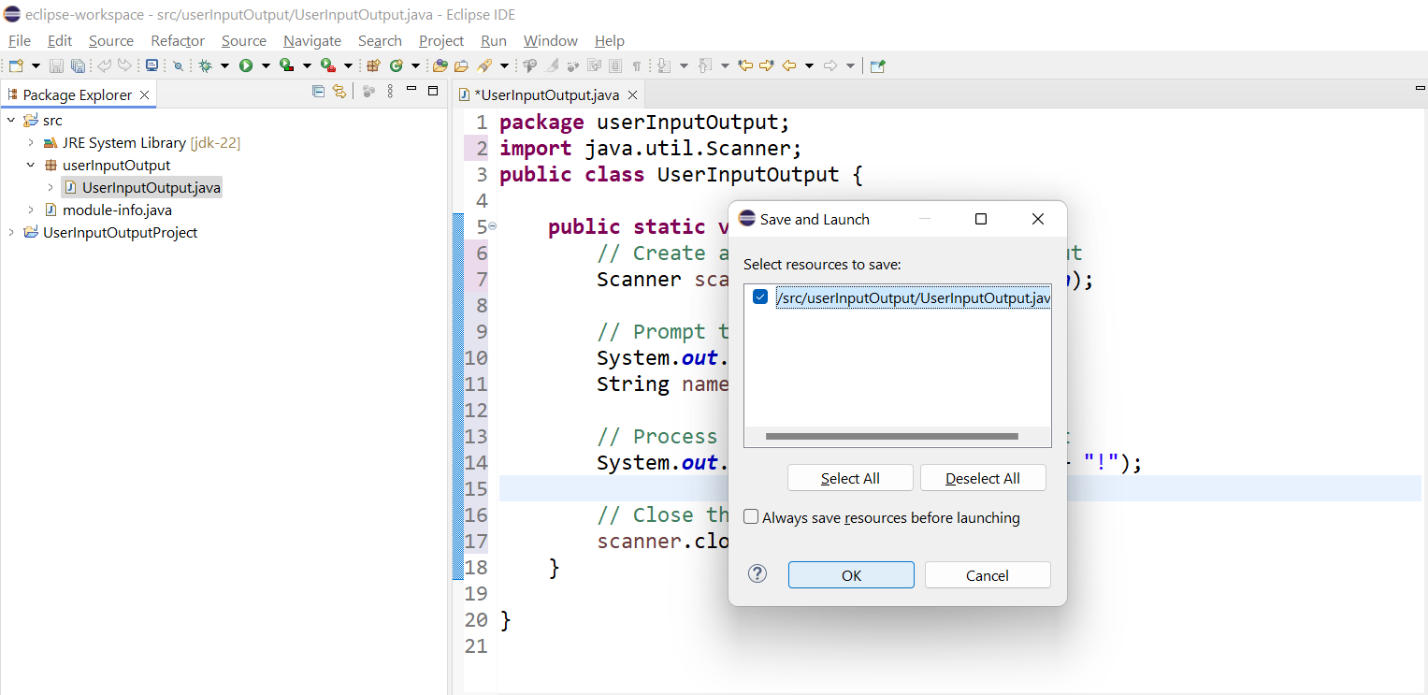
Select and Click on OK

Slide 44
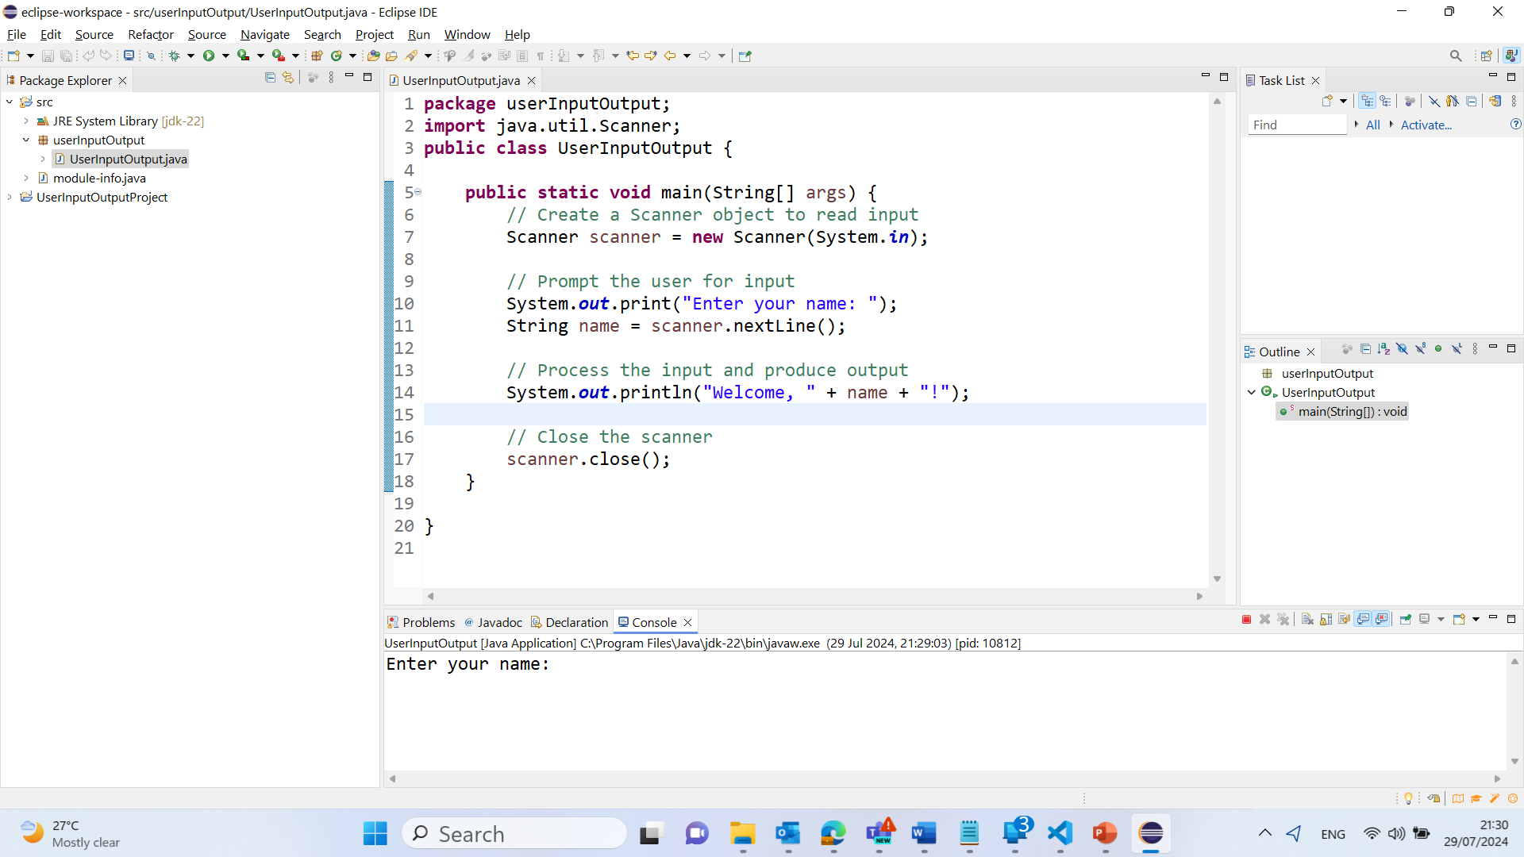
Output

Slide 45
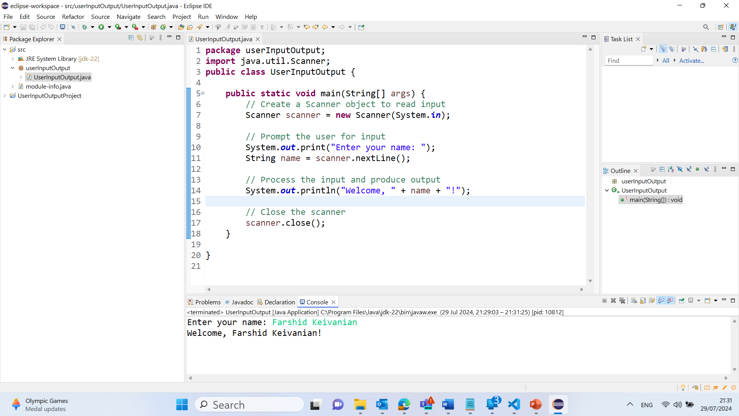
Output

Slide 46
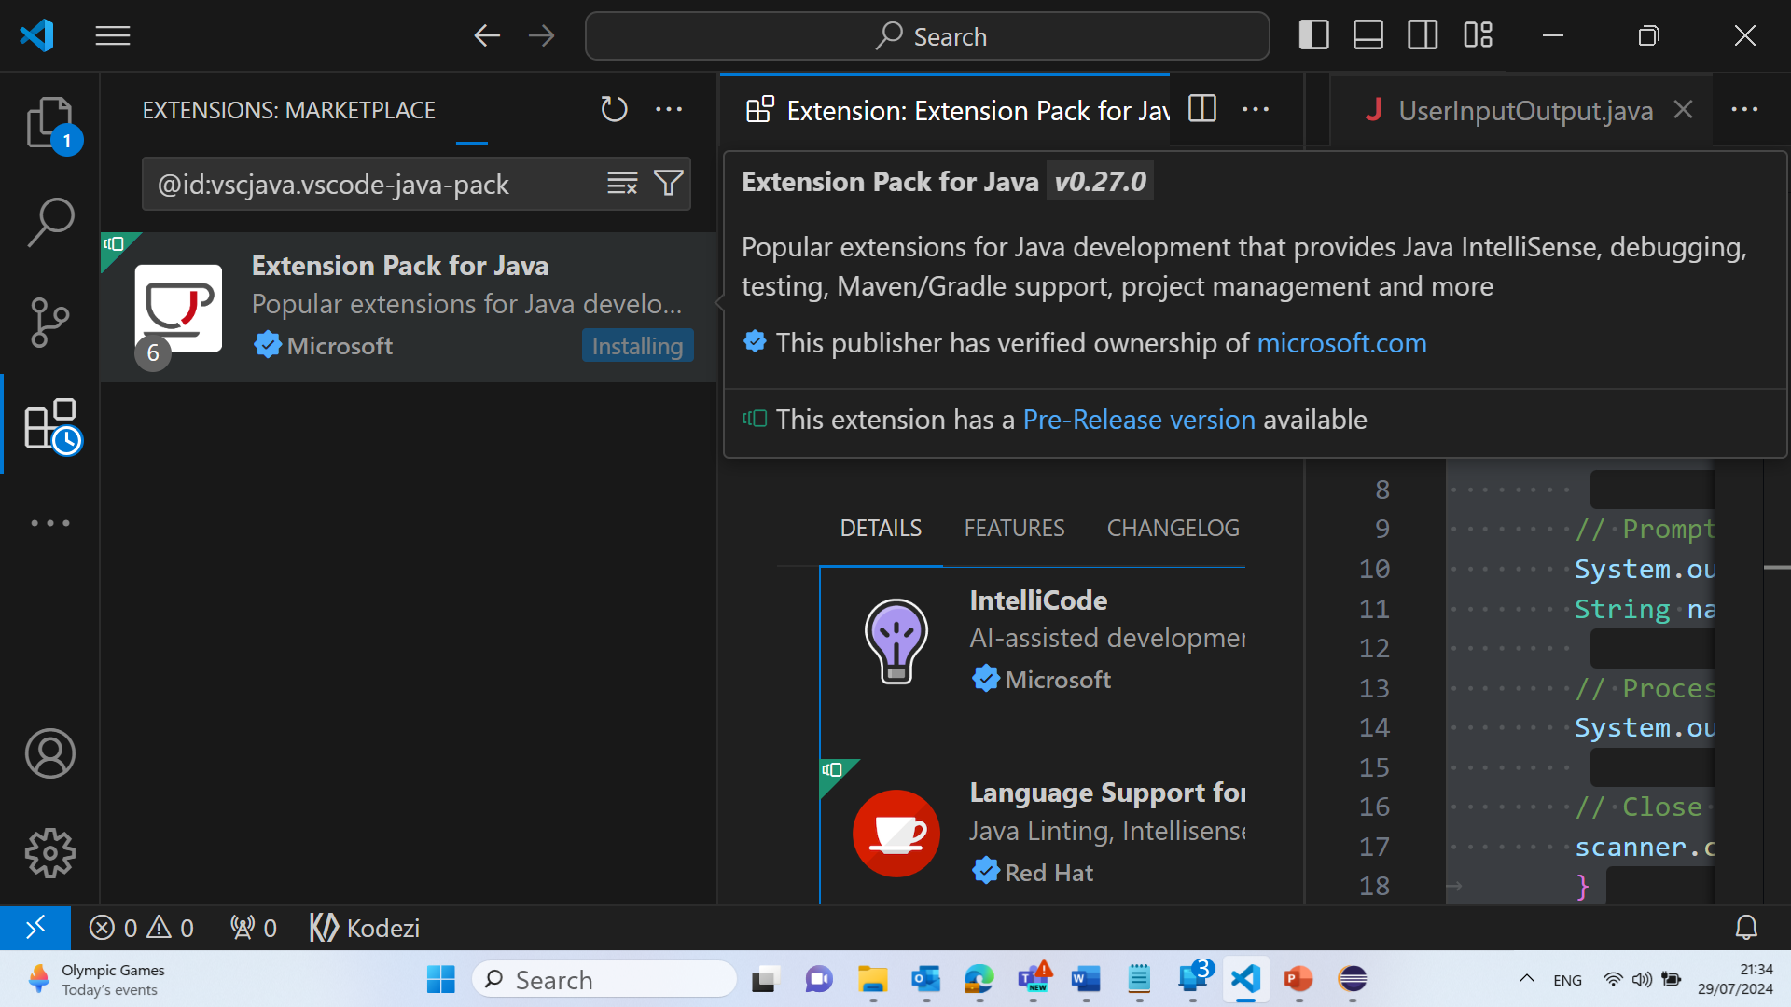
Visual Studio – Extension Pack for Java

